Slide 1

Hotel Demand and Cancellation Forecast
Brian Lui
Notes:
Welcome to my capstone project:
Hotel Demand and Cancellation Forecast

Slide 2


Machine Learning and the Hotel Industry
Hotels have daily limited perishable inventory
Unsold rooms = Lost Revenue
Overselling rooms:
Pay for a comparable hotel
Transportation costs
Damage to reputation and loyalty
Notes:
Have you ever wondered how managing a hotel works?
You might think they just need to sell as many rooms as possible right?
What if they sell too many? What if they don’t sell all of them?
A daily challenge hotels face is making sure they sell as many rooms as possible, without selling too many. That sounds simple enough right?
But think about this… <click>
A hotel has limited perishable inventory.
Unlike in other industries such as retail, inventory cannot be carried over the next day to be sold.
Any rooms that are left unsold is lost revenue
okay so then why would they oversell?
How often have you or a family member booked a hotel stay, work/leisure, but your plans changed?
<click>
Hotels need to account for that. If they are reactive, they risk underselling.
<click>
But...what if they end up oversold?
That guest gets refunded, walked to another hotel, (depending on the hotel’s policy):
They have to pay for a “comparable” hotel room
Pay transportation costs
Risks damaging their reputation and guest loyalty
If a hotel can accurately predict how many guests will stay for a given day, it will help them maximize revenue and help operations teams properly staff their hotel.

Slide 3
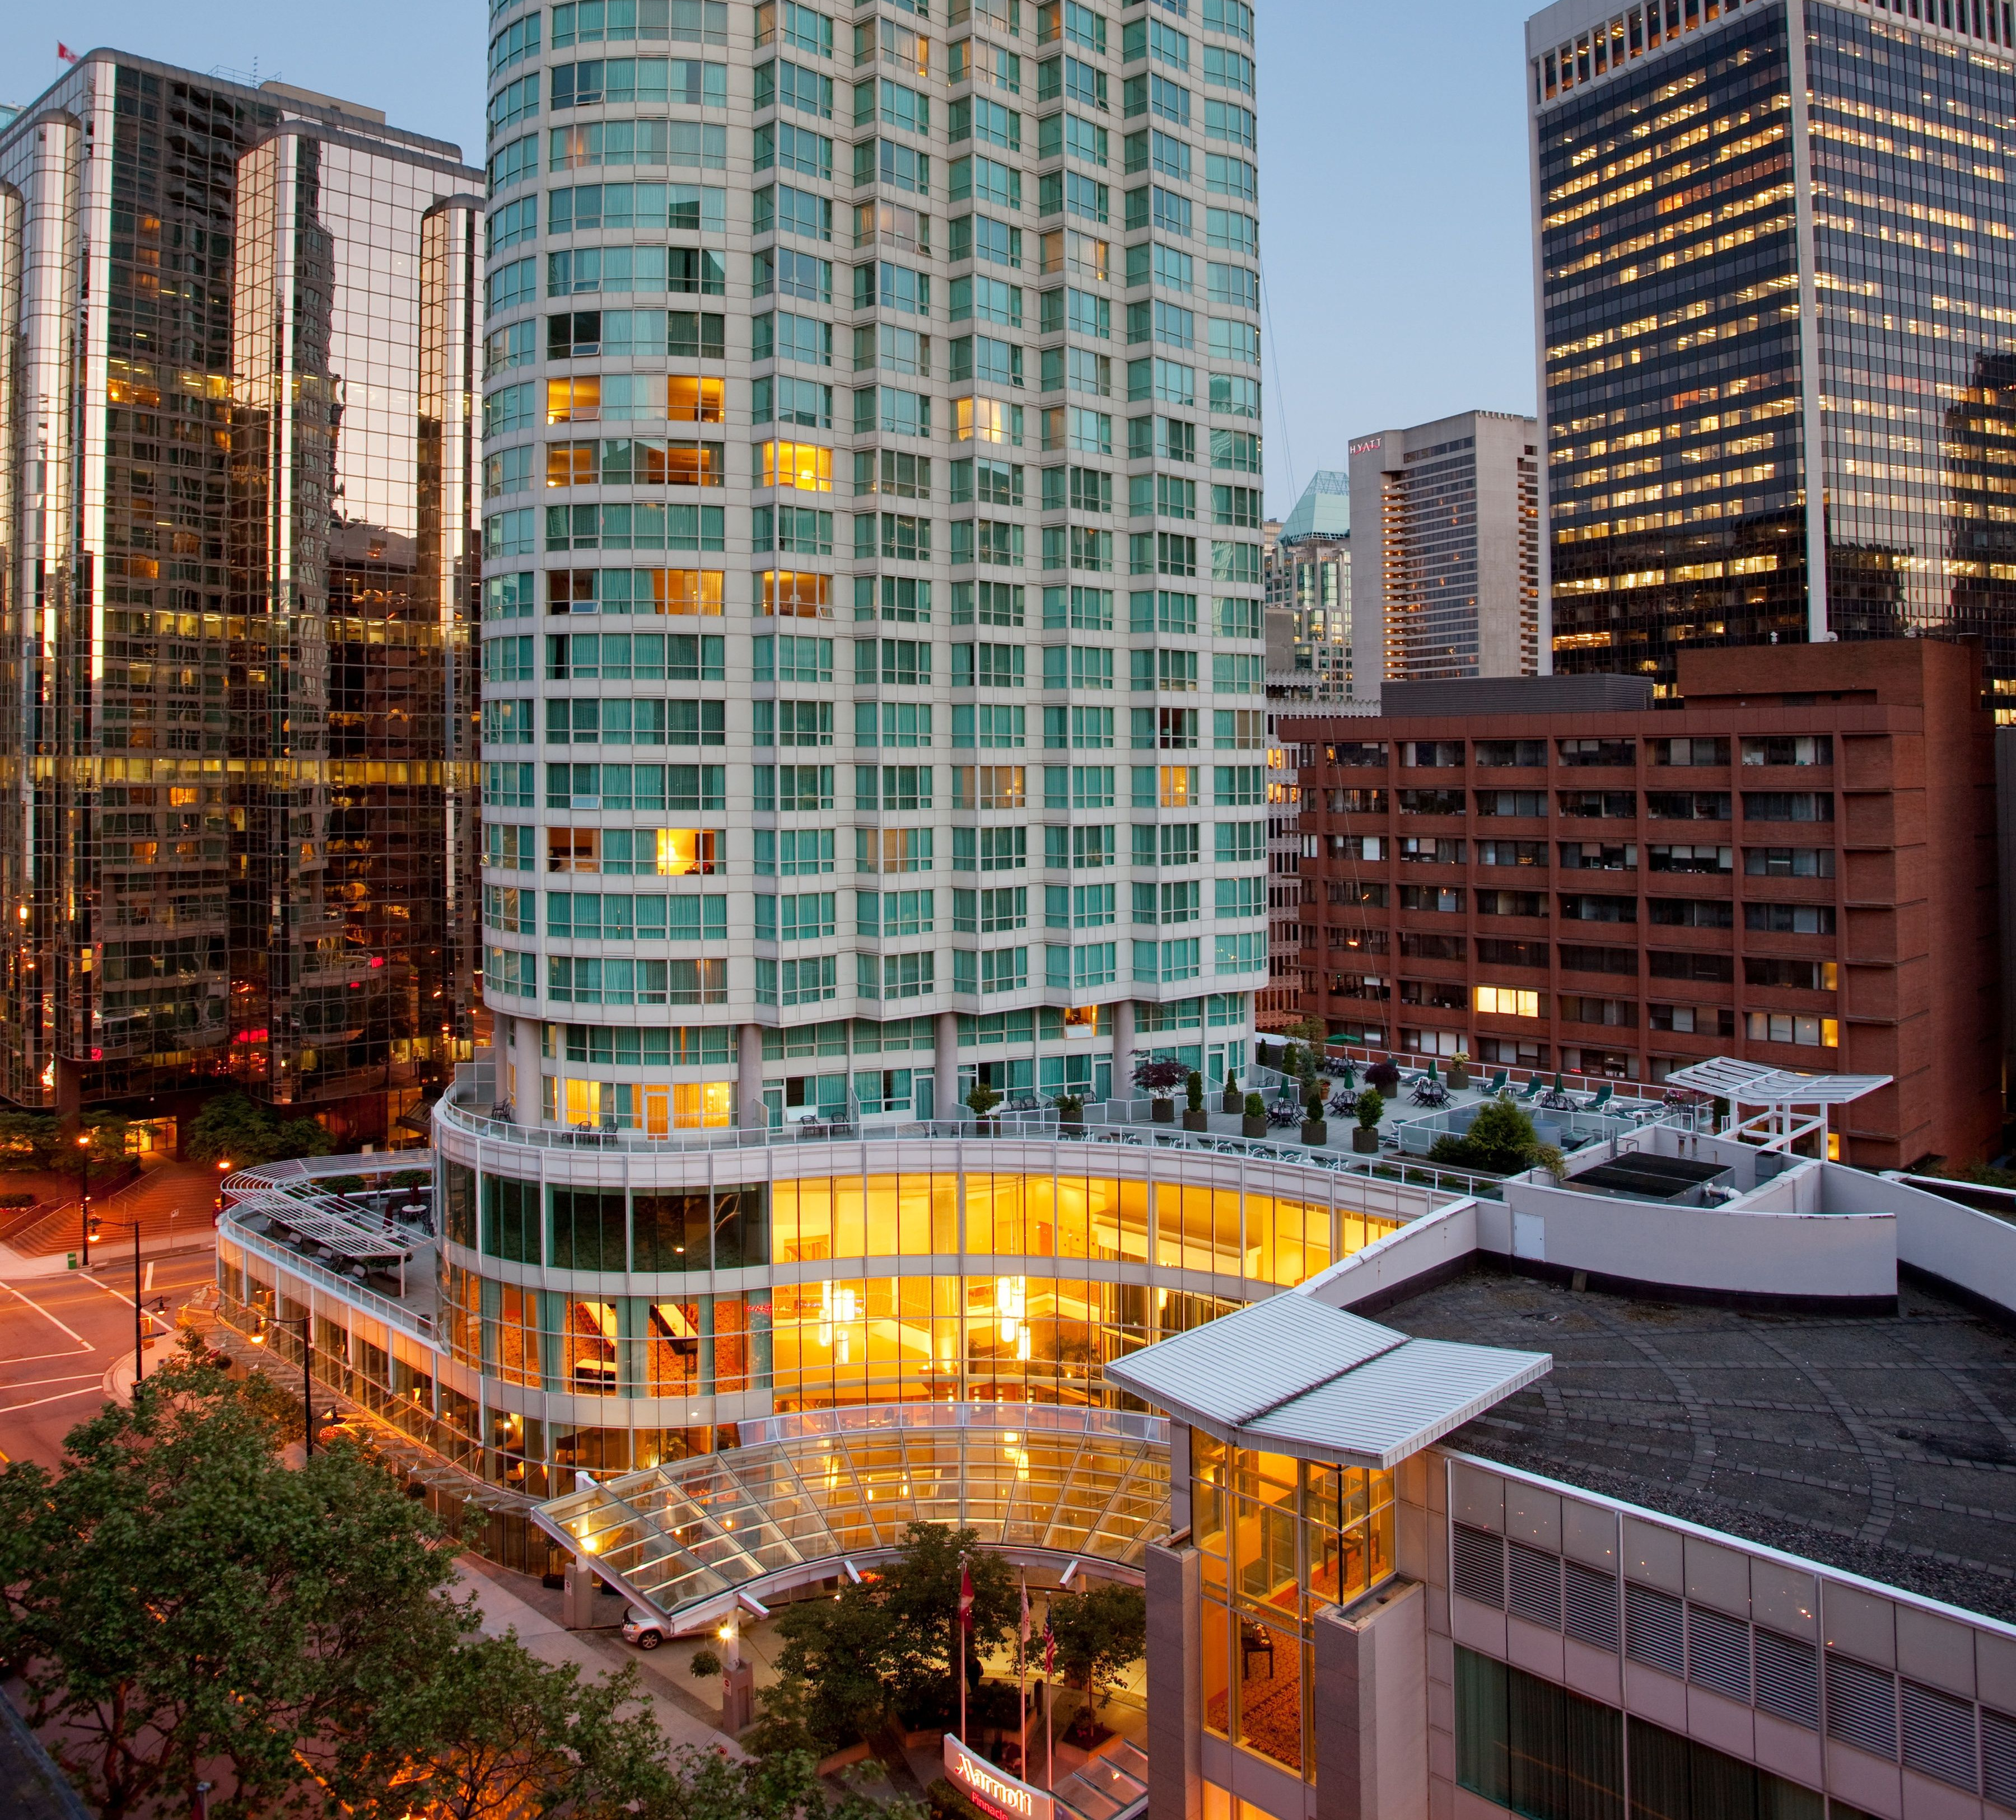

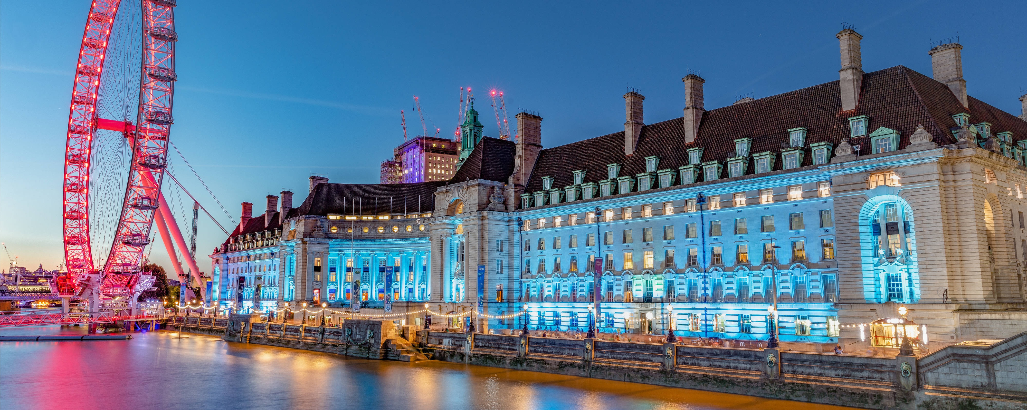
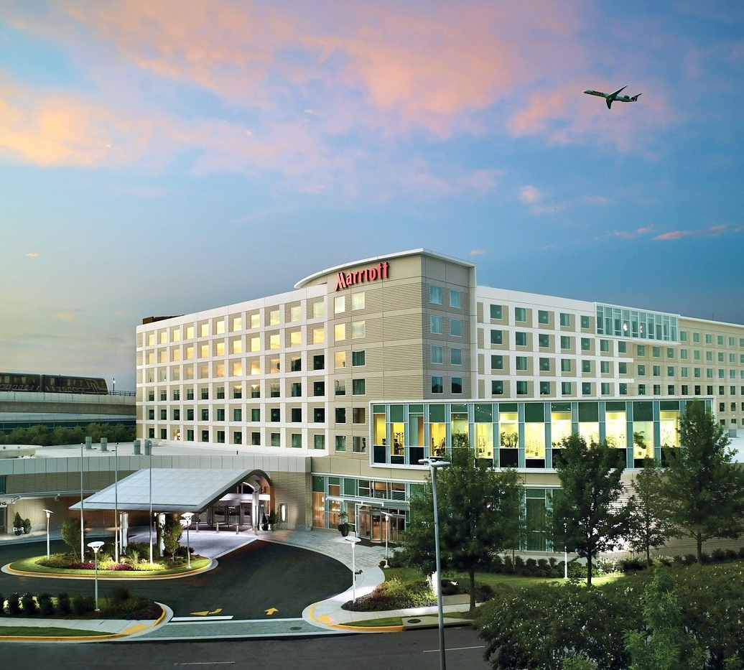
How Machine Learning Can Help
“Revenue Management: sell the right product to the right customer at the right time and at the right price”
Metrics of Success:
Maximize Revenue Per Available Room (RevPAR)
Reaching a ”perfect sell”
Predicting demand and cancellations to optimize pricing strategies
Notes:
Hotel owners and GM's begun to realize there is a high return on investment when it comes to proper revenue management systems
<CLICK>
For those who are unfamiliar, the goal of revenue management is
“selling the right product to the right customer at the right time for the right price”
<CLICK>
A revenue managers metrics of success might vary by property, but mainly consist of 2 things:
Maximizing the Revenue Per Available Room (RevPAR).
Reaching a “perfect sell”.
This means not finishing the day with any rooms unsold.
<CLICK>
The two biggest contributors to reaching that perfect sale are room demand and room cancellations.
How can Machine Learning help?
We can utilize ML models to predict demand and cancellation forecasts based on patterns from historical data, trends, and seasonality.
One Machine Learning approach we can use is leveraging time series forecasts.

Slide 4
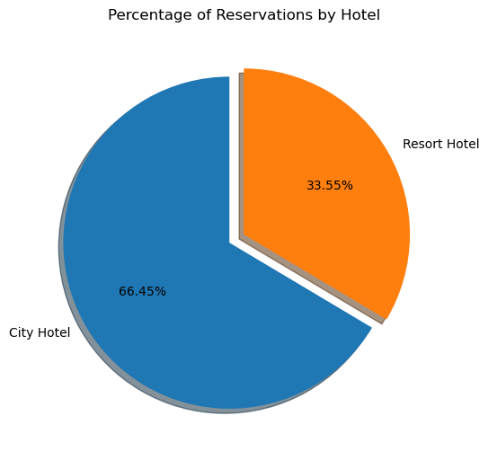
The Dataset
Important Columns:
is_canceled
Arrival_date (year, month, day of month)
Market_segment
Lead_time
Customer_type
Notes:
In my dataset there are 2 hotels, a City and Resort hotel in Portugal
Identities of the property and customers are anonymous due to privacy
The City hotel has over 79,000 reservations
The Resort hotel has 40,060 reservations
<CLICK>
After my initial look at the dataset, some important columns surfaced, but my main focus was on:
Is canceled
Arrival date (year, month, day of month)

Slide 5
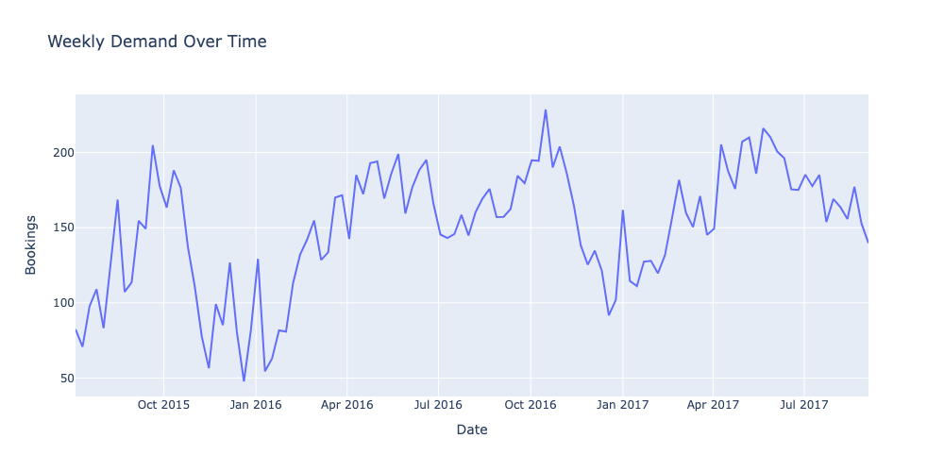
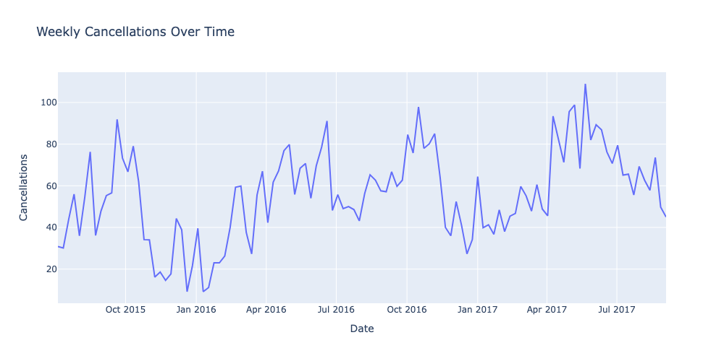
Initial EDA: Cancellation and Demand over Time
Seasonality seen between Demand and Cancellations
Peaks in October
Valleys in January
Increase in April
Notes:
My initial EDA led me to look at:
Weekly Demand(bookings) over time
Weekly Cancellations over time
Seasonality is visible for both Demand and Cxls
Peaks in October and April
Valleys in January
Only 2 years of data, but this looks like a trend

Slide 6
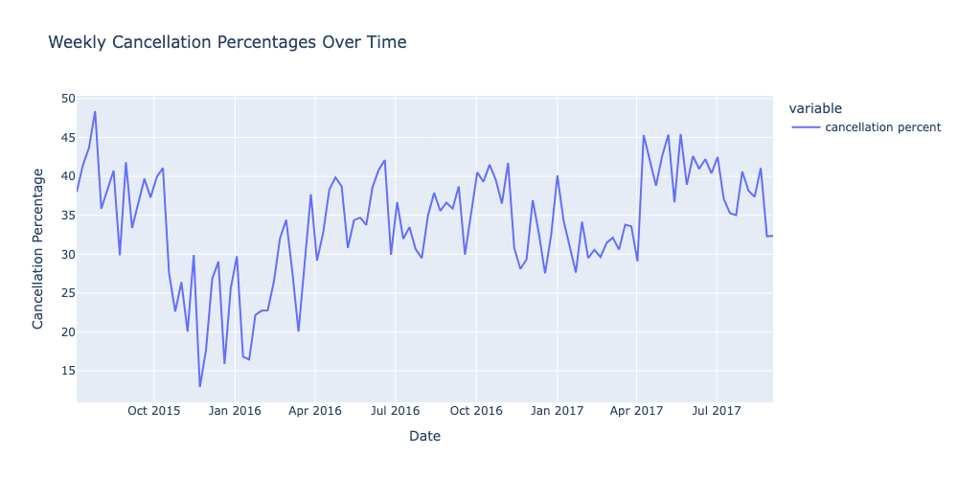
Cancellation Percentages
High cancellation % overall
Between 30-40% throughout the dataset
Identified large cancelled group bookings during EDA
Notes:
Looking at cancellation percentages:
It reaches almost 50%
And stays between 30-40% throughout the dataset
This looked high to me
In my EDA
Some reservations in the dataset were large group bookings that all cancelled
I want to isolate purely transient bookings to see if results will vary

Slide 7
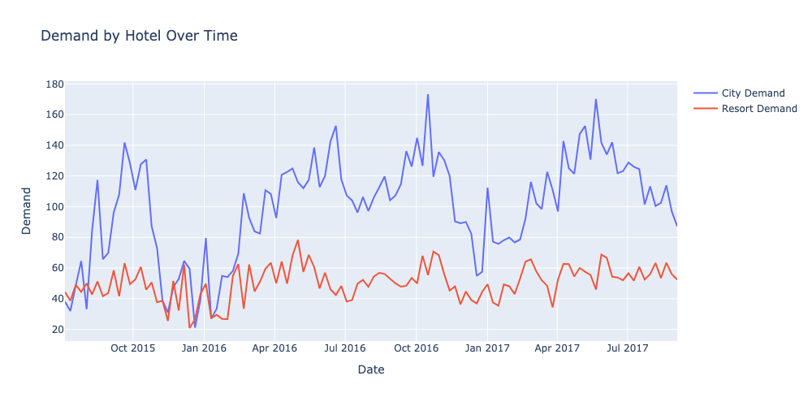
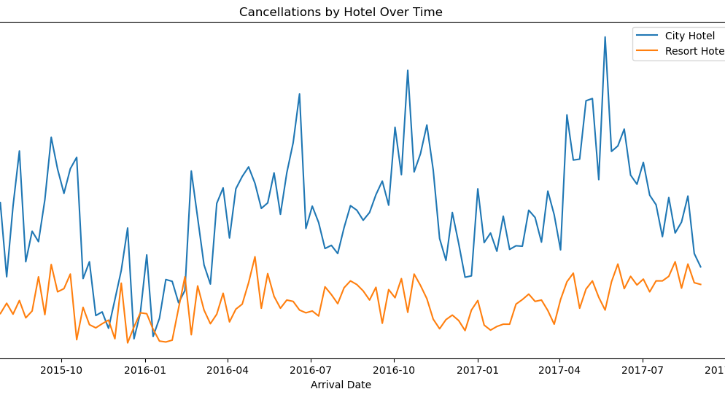
Demand and Cancellation by Hotel Type
City Hotel:
Higher demand and cancellations
Larger peaks and valleys
Likely influences the overall datasets trends
Cancellation Trends:
City hotels have corporate travelers
Last minute cancellations and bookings
Resort hotels have mainly leisure guests
Notes:
When I dove deeper to look at Demand and Cancellation by Hotel Type, I noticed:
<CLICK>
The City Hotel (Blue Lines)
has higher demand and cancellations compared to the Resort Hotel
has larger peaks and valleys compared resort hotel
The peaks and valleys we saw before, are most likely influenced by the city hotel
<CLICK>
The cancellation trends are reasonable because:
City hotels have tend to have higher corporate travelers
Last minute changes to bookings based on needs are frequent, so increased cancellations are expected
This holds true for demand as well, last minute needs to travel generates spikes in demand
Resort hotels target mainly leisure guests
When you’re traveling for vacation, you plan months or even years ahead.
It will take a lot more for you to cancel your travel plans compared to for a business trip

Slide 8
Next Steps
Further EDA
How does demand look like by Customer Type?
Do certain Market Segments or Distribution Channels have an increase in cancellations?
Trends between lead times and demand/cancellations?
Feature Engineering
Total Hotel Capacity
Rooms On the Books
Occupancy
Length of Stay
Remaining supply (Remaining Inventory to sell)
Pick Up
Booking Pace (variance YoY)
Notes:
<CLICK>
Next I want to dive deeper into understanding what demand looks like by customer type
Were my assumptions correct about Group bookings and the cancellations?
What about contract bookings? (airline crew)
Should I focus only on transient? (everything else)
<CLICK>
I want to look into the market segment and distribution level cancellations:
by market segment I mean:
Corporate Bookings
Online Travel Agents (Booking.com, Expedia, etc.)
Customer Call centers
Direct bookings
<CLICK>
What are the hotels booking windows? (lead time)
How far out are they booking?
How many days before day of arrival do they cancel?
<CLICK>
In terms of Feature Engineering
I want to create several features, but some that I’m most interested in are:
Total Hotel Capacity - (Max of reservations in a day)
Occupancy – (Total Capacity – Rooms OTB)
Length of Stay

Slide 9

Thank You

Slide 10
Feature Engineering
Total Hotel Capacity (Max of reservations in a day)
Rooms On the Books (Rooms booked by arrival day)
Occupancy (Total Capacity – Rooms OTB)
Length of Stay
Remaining supply (Remaining Inventory to sell)
Pick Up (Number of rooms sold in the last 1, 5, 7, 15+ days)
Booking Pace (variance to STLY rooms OTB, pickup, etc.)
Combine further EDA + feature engineering slides as Next Steps…to determine/find out what?

Slide 11
Introduce my approach and how does ML apply? Time series forecast demand and cancellation. No need to say more

